Slide 1
OS’22 Project
Milestone 1 Description
COMMAND PROMPT & DYNAMIC ALLOCATOR

Slide 2
Agenda
Logistics
Part 1: Command Prompt
Part 2: Dynamic Allocator
What’s New?
Lists
Dynamic Allocator and its Necessary Lists
Required Functions
Bonus
Testing
Project Quick Guide
How to submit?

Slide 3
Logistics
Startup Code:
FOS_PROJECT_2022_template.zip
Follow these steps to import the project folder into the eclipse
Delivery Method: GOOGLE FORMS
It’s FINAL delivery
MUST deliver the required tasks and ENSURE they’re worked correctly
Delivery Dates:
SAT of Week #5 (29/10/2022 @11:59 PM)
Upload your code EARLY as NO EXCEPTION will be accepted.
Support:
The support for teams will be through their MENTORS ONLY (+Lecturer) during the published weekly office hours.

Slide 4
Logistics
ADVICE#1: WORK AS A TEAM
Milestone 1 Functions:
Command Prompt ➔ 1 function
Dynamic Allocator ➔ 6 functions
Average # Functions / Member = 7 / 4 members
ADVICE#2: START immediately!
To have the chance to ask and to understand errors in your code in whatever you want during your mentor’s support before the deadline.
ADVICE#3: MUST read the ppt CAREFULLY
Detailed steps
Helper ready made functions (appendices)
≈ 1~2 Functions on 2 Weeks

Slide 5
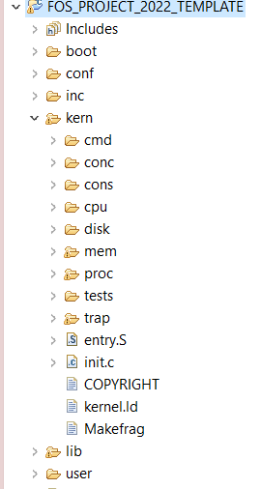





PROJECT BIG PICTURE
inc (.h)
lib (.c)
[MS1]
Dynamic Allocator
user
kern
[MS3]
User Heap
[MS2]
Kern Heap

Slide 6
Part1: Command Prompt
The main functions in part 1 are related to the command prompt.
They are similar to what is taken in Lab 1.
The objective of this part is to break the ice with the code and start navigate in it easily.
Required:
# | Function | File
1 | Autocomplete feature | All essential declarations in: kern/cmd/command_prompt.h Functions definitions TO DO in: kern/cmd/command_prompt.c

Slide 7
Part1: Command Prompt
Add an "Autocomplete" feature to your command prompt, which allow the user to list all commands that start with a given set of characters.
The user should write set of characters then press enter:
If the set of characters are complete and represent an existing command, then execute it (Already implemented).
Else, if there’s one (or more) command that start with the given characters, print their names (ONE PER LINE)
Else, print the “unknown command” message that is already exist in the given code.
Examples for TESTING:
FOS> kernel_info ➔ should execute the kernel_info command
FOS> he ➔ should print the commands that start with he
help
FOS> ru ➔ should print the commands that start with ru
rum
rub
rut
run
runall
FOS> smm ➔ unknown command (already exist in the given code)
Unknown command smm

Slide 8
Part1: Command Prompt
Function:
There's no specific function for this feature. However, you should choose the suitable place in the command prompt code to add this feature.
Helper Functions:
String functions (e.g. strncmp & strlen)
Refer to the Appendix of LAB1 documentation
How to test:
Write: FOS> autocomplete
This command run an automatic test for AUTOCOMPLETE.
To ensure your code correctness, the output MUST be the same as the given examples in the previous slide.

Slide 9
Agenda
Logistics
Part 1: Command Prompt
Part 2: Dynamic Allocator
What’s New?
Lists
Dynamic Allocator and its Necessary Lists
Required Functions
Bonus
Testing
Project Quick Guide
How to submit?

Slide 10
Objective
Handle memory blocks dynamically by using LISTS to allocate or free any required space either by the OS or any user program

Slide 11
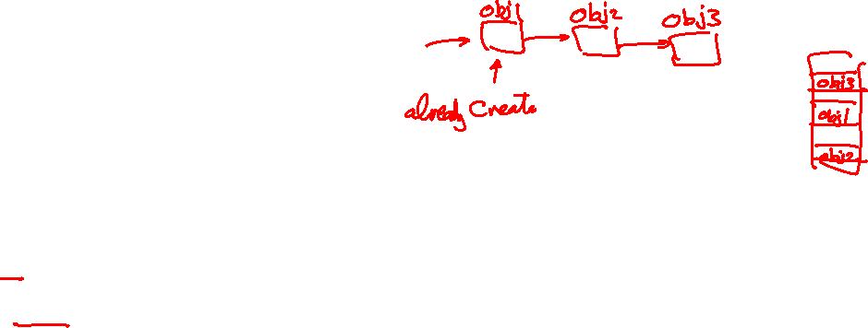
Introduction: Why LISTS?
Since we don’t know from the beginning what is the number of the blocks in memory will be needed later on to be created, so we need a dynamic allocation.
The one who is responsible for managing the dynamic allocation of any created array in memory is the OS.
However, this is NOT implemented yet in FOS (will be implemented later on by us).
In a trial to resolve this now WITHOUT dynamic allocation, we use LISTs instead of creating dynamic arrays.

Slide 12

Introduction: How to use LISTS?
Since there is no dynamic allocation now in FOS, we do the following:
Create static array
In order to workaround the static allocation to provide a kind of dynamic allocation, we create linked lists on the created static array.
Create a head pointer to points to the first element in the array.
Add next and previous pointers to each element in the array
0 | 1 | 2 | …. |  | n
List head

Slide 13
Introduction: How to use LISTS?
Nodes_List
Nodes_List: (0, 1, 5)
Now, we can control the elements of the created lists using the existing pointers in each element.
To add an element to the List:
Make the new element points to what the list’s head points to.
Then, make the list’s head points to the new element.
- To remove an element from the List:
Make the element’s previous pointer points to what is its next pointer points to.
0
1
2
3
4
5
Nodes_List
Nodes_List: (3, 0, 1, 5)
0
1
2
3
4
5
Nodes_List
Nodes_List: (3, 1, 5)
0
1
2
3
4
5

Slide 14
Agenda
Logistics
Part 1: Command Prompt
Part 2: Dynamic Allocator
What’s New?
Lists
Dynamic Allocator and its Necessary Lists
Required Functions
Bonus
Testing
Project Quick Guide
How to submit?

Slide 15

MS1: Dynamic Allocator
Virtual Memory
.
.
.
Block 4
Memory is composed of free and allocated blocks.
So, in order to keep track of all blocks in memory, we create an array of static number of blocks to be used later on by lists:
Name: “MemBlockNodes”
Size: STATIC number of available blocks, called “MAX_MEM_BLOCK_CNT”
Type: “struct MemBlock” that contains some information about the block which are:
Block 3
P₁₀₀
.
.
.
Block 2
0 | 1 | 2 | …. |  | n
P₂
Block 1
size
SVA
P₁
MemBlock_LIST_entry_t prev_next_info;/*list link*/
uint32 sva ; //start virtual address
uint32 size;//block size
Block 0
P₀
Green: Free blocks
Red: Allocated blocks

Slide 16

MS1: Dynamic Allocator (Cont.)
Virtual Memory
430KB
.
.
.
Block 4
404KB
BLOCK: It refers to either any reserved (allocated) space or free space.
We have 3 lists operated on “MemBlockNodes” array to mange dynamic memory blocks, they are:
AvailableMemBlocksList: List of all available blocks (Status: Neither free nor allocated)
FreeMemBlocksList: List of free blocks in memory (Status: Free space)
AllocMemBlocksList: List of allocated blocks in memory (Status: Allocated space)
Block 3
P₁₀₀
400KB
.
.
.
Block 2
12KB
FreeMemBlocksList
P₂
AvailableMemBlocksList
Block 1
size
8KB
AllocMemBlocksList
P₁
Block # MAX_MEM_BLOCK_CNT
SVA
Block 0
Block 1
Block 2
Block 3
Block 4
Block 5
Block 6
4KB
Sva=0 Sze=4K | Sva=4k Sze=8k | Sva=12K Size=388k | Sva=400K Size=4K | Sva=404 size=16K |  |  | ......
Block 0
P₀
0
Green: Free blocks
Red: Allocated blocks
MemBlockNodes Array

Slide 17
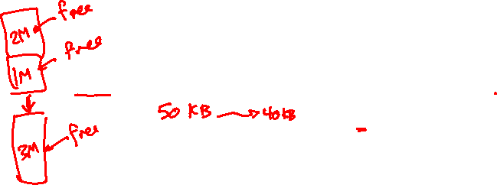
MS1: Dynamic Allocator (Cont.)
Virtual Memory
430KB
.
.
.
Block 4
404KB
Relationship between the 3 lists is
Block 3
P₁₀₀
400KB
AvailableMemBlocksList
.
.
.
1
Block 2
5
4
12KB
2
P₂
FreeMemBlocksList
AllocMemBlocksList
Block 1
size
8KB
3
P₁
SVA
4KB
Block 0
P₀
0
Green: Free blocks
Red: Allocated blocks
Notes:
- “1” is occurred when:
Scenario 1: First the memory is empty, so it is considered ONE free block. In this case a block from the AvailableMemBlocksList is removed to be exist as a free block in the FreeMemBlocksList.
- “2” is occurred when:
When we need to free a block by returning it back to the FreeMemBlocksList, while its found that it is adjacent to one of the existing free blocks in the FreeMemBlocksList. In this case the existing block is merged with the new free block in ONE block by updating its size and the sva .. While the free block itself returned back to the AvailableMemBlocksList since no need to it.
- “3” is occurred when:
When we need to allocate a free block and the appropriate existing one in the FreeMemBlocksList has the same the size of the required size. In this case the free block is removed from the FreeMemBlocksList to be inserted in the AllocMemBlocksList.
- “4” is occurred when:
When we need to allocate a free block, while its size is greater than the required size .. In this case we leave the main block in the FreeMemBlocksList with updating it with the remaining size. Then, a new block from the AvailableMemBlocksList is removed to be updated with the required size and allocated in the AllocMemBlocksList.

Slide 18
Agenda
Logistics
Part 1: Command Prompt
Part 2: Dynamic Allocator
What’s New?
Lists
Dynamic Allocator and its Necessary Lists
Required Functions
Bonus
Testing
Project Quick Guide
How to submit?

Slide 19
Part2: Dynamic Allocator
The main functions required by MS1 to handle “Dynamic Allocator” are:
# | Function | File
1 | initialize_MemBlocksList | All essential declarations in: inc/dynamic_allocator.h Functions definitions TO DO in: Lib/dynamic_allocator.c
2 | find_block
3 | insert_sorted_allocList
4 | alloc_block_FF
5 | alloc_block_BF
6 | insert_sorted_with_merge_freeList
BONUS | alloc_block_NF

Slide 20

MS1: Dynamic Allocator Required Functions 1- initialize_MemBlocksList
Function Declaration:
void initialize_MemBlocksList(uint32 numOfBlocks)
Function Role:
Currently, the “MemBlockNodes” array is already created with empty “MAX_MEM_BLOCK_CNT” block elements.
“AvailableMemBlocksList” is empty without any pointers or nodes.
This function shall:
ZEROing the size & pointers of “AvailableMemBlocksList”.
Then, fill the list by making it points to the first n=numOfBlocks empty elements exist in “MemBlockNodes” array.
At the end of this function, the “AvailableMemBlocksList” shall be initialized as a linked list of “numOfBlocks” elements from those that already exist in the “MemBlockNodes” array.
MemBlockNodes Array
AvailableMemBlocksList
Sva = 0 Size =0 | Sva = 0 Size =0 | Sva = 0 Size =0 | Sva = 0 Size =0 | Sva = 0 Size =0 | Sva = 0 Size =0 | Sva = 0 Size =0 |  |  | Sva = 0 Size =0
0
1
2
3
…
numOfBlocks
MAX_MEM_BLOCK_CNT

Slide 21
MS1: Dynamic Allocator Required Functions 1- initialize_MemBlocksList (Cont.)
Helper ready made functions:
To be able to use any linked list as “AvailableMemBlocksList”, we must initialize it first as follows:
LIST_INIT(&List_name);
This function initializes the list’s head by null pointers and its size by 0.
To add an element from a specific static array to any linked list, use the following function:
LIST_INSERT_HEAD(&List_name, &(array_name[i]));
Adding an element to a linked list already explained before here.
HINT: Take care the list and the array’s element are passed to LIST_INSERT_HEAD by reference.
NOTE: All remaining functions you may need to treat with LISTS are existing here.

Slide 22

MS1: Dynamic Allocator Required Functions 2- find_block
Function Declaration:
struct MemBlock *find_block(struct MemBlock_List *blockList, uint32 va)
Function Role:
It shall search for the given start virtual address (va) in the given list (blockList).
If a block found with sva equal to given va, return this block.
If not found, return NULL.
MemBlock
uint32 sva ; //start va
uint32 size;//block size
?
FreeMemBlocksList
VA
AllocMemBlocksList
NULL

Slide 23
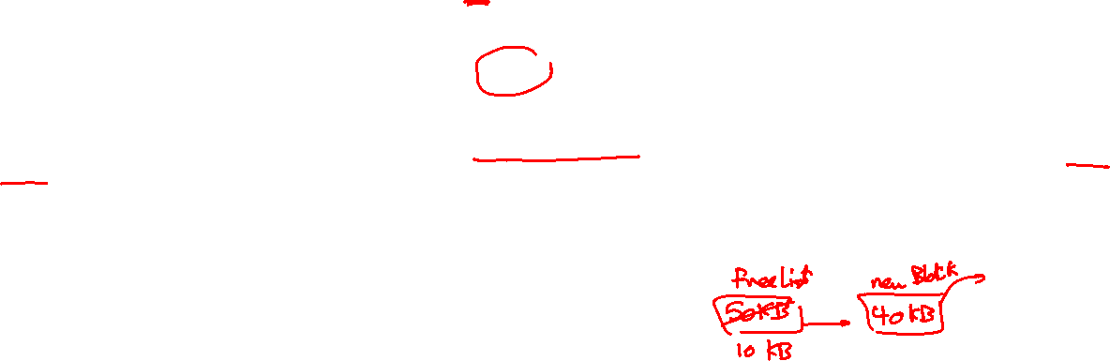
MS1: Dynamic Allocator Required Functions 3- alloc_block_FF
Function Declaration:
struct MemBlock *alloc_block_FF(uint32 size)
Function Role:
This function searches for a free memory block in the FreeMemBlocksList with a size greater than or equal input size using FIRST FIT STRATEGY to be allocated later on in the memory.
The possible CASES results from the search using FF strategy are:
Case 1: no suitable block is found ➔ return NULL.
Case 2: a block is found with EXACT size ➔ remove it from the FreeMemBlocksList and return it.
Case 3: a block is found with GREATER size ➔ divide it into 2 blocks:
A new block with the required size, shall be RETURNED by the end of the function.
An updated block with the remaining space, shall be kept in the list

Slide 24

MS1: Dynamic Allocator Required Functions 3- alloc_block_FF (Case 1)
Case 1 example: Input size = 9 KB
All existent free blocks’ sizes smaller than the input required size, so return NULL.
FreeMemBlocksList
AvailableMemBlocksList
Sva=0
Size=1K
Sva=40k
Size=8k
Sva=80k
Size=4k
MemBlockNodes Array

Slide 25

MS1: Dynamic Allocator Required Functions 3- alloc_block_FF (Case 2)
FreeMemBlocksList
AvailableMemBlocksList
Sva=0
Size=1K
Sva=40k
Size=8k
Sva=80k
Size=4k
Case 2 example: Input size = 8 KB
The free block found by applying FF has a size equal to the given size.
In this case remove it from the FreeMemBlocksList.
Return the found block.
Sva=40k
Size=8k
MemBlockNodes Array
FreeMemBlocksList
AvailableMemBlocksList
Sva=0
Size=1K
Sva=40k
Size=8k
Sva=80k
Size=4k

Slide 26

MS1: Dynamic Allocator Required Functions 3- alloc_block_FF (Case 3)
Case 3 example: Input size = 4 KB
The free block found by applying FF has a size greater than the given size, then:
A new block for required size shall be created
An updated block with the remaining space .
Return back the new block.
FreeMemBlocksList
AvailableMemBlocksList
Sva=0
Size=1K
Sva=40k
Size=8k
Sva=80k
Size=4k
Sva=40k
Size=8k
MemBlockNodes Array
FreeMemBlocksList
AvailableMemBlocksList
Sva=0
Size=1K
Sva=40k
Size=8k
Sva=80k
Size=4k
Sva=40k
Size=4kb
FreeMemBlocksList
AvailableMemBlocksList
Sva=0
Size=1K
Sva=44k
Size=4k
Sva=80k
Size=4k
Sva=40k
Size=4kb

Slide 27

MS1: Dynamic Allocator Required Functions 4- alloc_block_BF
Function Declaration:
struct MemBlock *alloc_block_BF(uint32 size)
Function Role:
This function searches for a free memory block in the FreeMemBlocksList with a size greater than or equal input size using BEST FIT STRATEGY to be allocated later on in the memory.
The possible CASES results from the search using BF strategy are the same that can be occurred by applying FF.

Slide 28
MS1: Dynamic Allocator Required Functions 5- insert_sorted_allocList
Function Declaration:
void insert_sorted_allocList(struct MemBlock *blockToInsert)
Function Role:
This function takes a block and insert it in the AllocMemBlocksList.
All blocks inserted in AllocMemBlocksList are placed in a sorted ascending order based on each block’s sva.
It has two cases:
Case 1: If the AllocMemBlocksList is empty ➔ insert the given block at the head of the list.
Case 2: Otherwise ➔ insert the given block in its correct location according to its sva (simply by iterate on the AllocMemBlocksList).

Slide 29
MS1: Dynamic Allocator Required Functions 5- insert_sorted_allocList (Example)
Case 1 Example: If the blockToInsert is as follows
Case 2 Example 1: If the blockToInsert is as follows
Case 2 Example 2: If the blockToInsert is as follows
AllocMemBlocksList
AvailableMemBlocksList
Sva=0
Size=4K
MemBlockNodes Array
Sva=12k
Size=1k
AllocMemBlocksList
AvailableMemBlocksList
Sva=0
Size=4K
Sva=4k
Size=7k
Sva=40k
Size=12k
Sva=90K
Size=1k

Slide 30
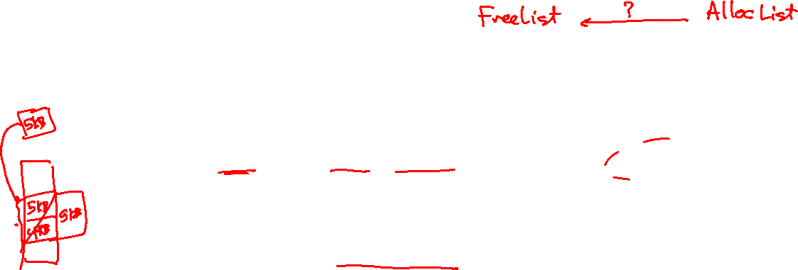
MS1: Dynamic Allocator Required Functions 6- insert_sorted_with_merge_freeList
Function Declaration:
void insert_sorted_with_merge_freeList(struct MemBlock *blockToInsert)
Function Role:
It takes a block and insert it in the FreeMemBlocksList.
All blocks inserted in FreeMemBlocksList are placed in a sorted ascending order based on each block’s sva.
However, if the inserted block is DIRECTLY adjacent to another free block (either before or after it) ➔ they shall be merged as ONE block.
It has the following cases:
Case 1: If the FreeMemBlocksList is empty ➔ insert the given block at the head of the list.
Otherwise ➔ insert the given block in its correct location according to its sva (simply by iterate on the FreeMemBlocksList). Here, one of the following four cases can be happened:
Case 2: No merge
Case 3: Merge with previous
Case 4: Merge with next
Case 5: Merge with previous and next

Slide 31
MS1: Dynamic Allocator Required Functions 6- insert_sorted_with_merge_freeList (Case 1)
- Case 1 Example: If the blockToInsert is as follows:
If the list is empty ➔ add it to the head.
FreeMemBlocksList
FreeMemBlocksList
AvailableMemBlocksList
Sva=0
Size=4K
MemBlockNodes Array
MemBlockNodes Array

Slide 32

MS1: Dynamic Allocator Required Functions 6- insert_sorted_with_merge_freeList (Case 2)
- Case 2 – NO MERGE: If the blockToInsert is as follows
If the given block is NOT DIRECTLY ADJACENT to its next and previous free blocks ➔ add it without merge.
Sva=40K
Size=10K
FreeMemBlocksList
AvailableMemBlocksList
Sva=0
Size=4K
Sva=12K
Size=8K
Sva=80K
Size=3K
Note: Take care that through iterating the FreeMemBlocksList you can find either the NEXT or the PREVIOUS with NULL.
In this case, link the given block with whatever exists.

Slide 33

MS1: Dynamic Allocator Required Functions 6- insert_sorted_with_merge_freeList (Case 3)
- Case 3 – MERGE with PREVIOUS: If the blockToInsert is as follows
If the given block is DIRECTLY ADJACENT to its previous free block ➔ merge them into one block.
Sva=20k
Size=2K
FreeMemBlocksList
AvailableMemBlocksList
Sva=0
Size=4K
Sva=12K
Size=8K
Sva=12K
Size=10K
Sva=80K
Size=3K
12K+8K=20K
Sva=0
Size=0

Slide 34

MS1: Dynamic Allocator Required Functions 6- insert_sorted_with_merge_freeList (Case 4)
- Case 4 – MERGE with NEXT: If the blockToInsert is as follows
If the given block is DIRECTLY ADJACENT to its next free block ➔ merge them into one block.
Sva=70k
Size=10K
FreeMemBlocksList
AvailableMemBlocksList
Sva=0
Size=4K
Sva=12K
Size=8K
Sva=80K
Size=3K
Sva=70K
Size=13K
70K+10K=80K
Sva=0
Size=0

Slide 35
MS1: Dynamic Allocator Required Functions 6- insert_sorted_with_merge_freeList (Case 5)
Sva=20K
Size=60K
- Case 5 – MERGE with PREVIOUS & NEXT: If the blockToInsert is as follows
If the given block is DIRECTLY ADJACENT to its next free block ➔ merge the THREE blocks into one block.
FreeMemBlocksList
Sva=0
Size=4K
Sva=12K
Size=71K
Sva=12K
Size=8K
Sva=80K
Size=3K
….
Sva=0
Size=0
12K+8K=20K
20K+60K=80K
AvailableMemBlocksList
Sva=0
Size=0

Slide 36
Agenda
Logistics
Part 1: Command Prompt
Part 2: Dynamic Allocator
What’s New?
Lists
Dynamic Allocator and its Necessary Lists
Required Functions
Bonus
Testing
Project Quick Guide
How to submit?

Slide 37

MS1: Bonuses 1: alloc_block_NF
Function Declaration:
struct MemBlock *alloc_block_NF(uint32 size)
Function Role:
This function searches for a free memory block in the FreeMemBlocksList with a size greater than or equal input size using NEXT FIT STRATEGY to be allocated later on in the memory.
The possible CASES results from the search using NF strategy are the same as FF & BF.
Note: Take care that the next fit starts searching from the last allocated address.
So, if you reached the end of the FreeMemBlocksList and don’t find appropriate space in it, you shall start search from the beginning of the list.

Slide 38

MS1 Testing Dynamic Allocator Testing
Test each function in Part2 independently in a FRESH SEPARATE RUN.
# | Function | Test
1 | initialize_MemBlocksList | FOS> tstlsts init
2 | find_block | FOS> tstlsts find
3 | insert_sorted_allocList | FOS> tstlsts insrt
4 | alloc_block_FF | FOS> tstlsts FF
5 | alloc_block_BF | FOS> tstlsts BF
6 | insert_sorted_with_merge_freeList | FOS> tstlsts merge
BONUS | alloc_block_NF | FOS> tstlsts NF
"Congratulations!! test [TEST NAME] completed successfully.”
To ensure the success of a test a congratulations message like this MUST be appeared without any ERROR messages or PANICs.

Slide 39
MS1 Testing Instructions
Test each function in MS1 independently in a FRESH SEPARATE RUN.
The individual tests MUST meet the following time limits:
All individual tests: max of 1 min / each
During your solution, don't change any file EXCEPT those who contain "TODO“.

Slide 40
Agenda
Logistics
Part 1: Command Prompt
Part 2: Dynamic Allocator
What’s New?
Lists
Dynamic Allocator and its Necessary Lists
Required Functions
Bonus
Testing
Project Quick Guide
How to submit?

Slide 41

Startup Code
FOS_PROJECT_2022_Template.Zip
Follow these steps to import the project folder into the eclipse

Slide 42
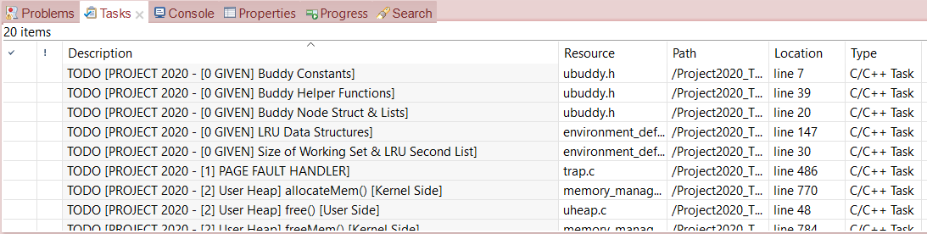
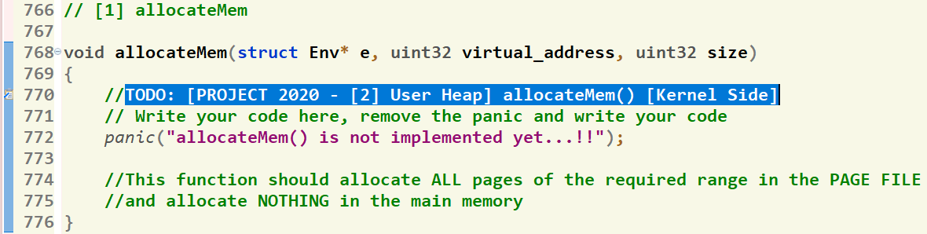
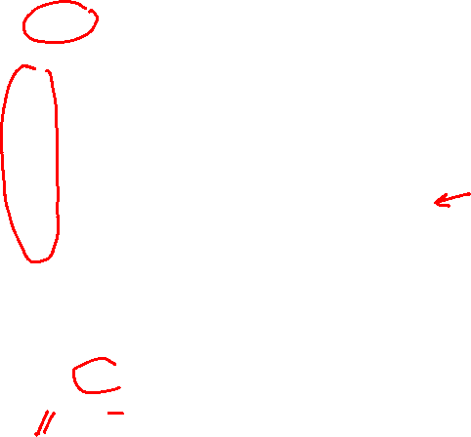
Where should I write the Code?
There’re shortcut links that direct you to the function definition
[1] Click on “Tasks” Tab
[2] Double Click on the required function
GIVEN
REQUIRED
[3] Function body, at which you should write the code
42

Slide 43
Helper Ready Made Functions
Set of ready-made LIST functions are available to help you when writing your solution.
Detailed description can be found in this document.

Slide 44
Agenda
Logistics
Part 1: Command Prompt
Part 2: Dynamic Allocator
What’s New?
Lists
Dynamic Allocator and its Necessary Lists
Required Functions
Bonus
Testing
Project Quick Guide
How to submit?

Slide 45
Submission Rules
Read the following instructions as the code correction is done AUTOMATICALLY. Any violation in these rules will lead to 0 and nothing in this case couldn’t happened.
First ensure the following that (READ CAREFULLY):
You tested each function in a FRESH RUN and a congratulations message have been appeared.
You submitted BEFORE the deadline by several hours to AVOID any internet problems.
DEADLINE: SAT of Week #5 (29/10/2022 @11:59 PM)
ONLY ONE person from the team shall submit the code.
The TEAM # MUST BE CORRECT.
NO DELAYED submissions WILL BE ACCEPTED.
NO CODE with errors WILL BE CORRECTED. So, CLEAN & RUN your project several times before your submission.
DON’T take the FORM LINK FROM ANYONE. OPEN the form from its LINK HERE ONLY. Otherwise, your submission is AUTOMATICALLY CANCELLED by GOOGLE.
You MUST RECEIVE A MAIL FROM GOOGLE with your submission after clicking submit. If nothing received, re-submit again to consider your submission.

Slide 46

Submission Steps
STEPS to SUBMIT:
Clean & run your code the last time to ensure that there are any errors.
Open the form from HERE.
Fill your team’s info .. Any wrong information will cancel your submission, revise them well.
Copy ALL the code in the Lib/dynamic_allocator.c file by (CTRL + A) & PASTE it in the form in the “Lib/dynamic_allocator.c” part.
Copy ALL the code in the kern/cmd/command_prompt.c file by (CTRL + A) & PASTE it in the form in the “kern/cmd/command_prompt.c” part.
CLICK ON SUBMIT.
You MUST RECEIVE A MAIL from GOOGLE with your submission, otherwise re-submit again.
Submission ISSUE
After CLICKING submit, if error message with “Submission is too long” is appeared.
Resolve it by doing the following.

Slide 47
Thank you for your care…
Enjoy making your own FOS ☺

